Slide 1

Apriori Algorithm Project Muhammad Aown Ali Muhammad Junaid Ali Asif Raja M11217077 M11217073
​
​

Slide 2

Data Preprocessing

Slide 3

Data Preprocessing
The preprocessing steps for the Apriori algorithm start with installing the `mlxtend` library. Next, transaction data from `data.txt` is loaded, typically in a list-of-lists format. This raw data needs transformation for the algorithm.
Using `TransactionEncoder` from `mlxtend`, the data is converted into a one-hot encoded DataFrame, where columns represent items and rows represent transactions. The `apriori` function then identifies frequent itemsets from this transformed data. Finally, the frequent itemsets are printed for further analysis or use.

Slide 4

Data Preprocessing (Cont.) Approach 1 (data.txt)
In our code, data preprocessing involves reading transaction data from a file and converting it into a format suitable for frequent itemset mining. Each transaction is read from the file, with items separated by commas and converted into a list of items. This step ensures that the data is structured and prepared for efficient analysis using the Apriori algorithm.
Next, the transactions are processed by a handler class that indexes items to their respective transactions, allowing for quick support calculations. This preprocessing step cleans and organizes the raw transaction data, making it ready for identifying frequent itemsets based on specified minimum support thresholds.

Slide 5
Data Preprocessing (Cont.) Approach 2 (music.txt)
The code implements the Apriori algorithm to identify
frequent itemsets in transaction data. It reads transactions
from a file and organizes them into a list of lists, with each
inner list containing items from a single transaction. The
`TransactionsHandler` class indexes these items to their
respective transactions, enabling quick calculation of
itemset support and iterating until no further frequent
itemsets can be found.
The `TransactionsHandler` class efficiently manages and
filters transactions by support, storing item indices and
calculating support for candidate itemsets. This ensures the
Apriori algorithm quickly identifies valid itemsets that meet
the minimum support criteria. The final output provides
frequent itemsets with their counts and support levels,
printed for various minimum support thresholds.

Slide 6

Algorithm

Slide 7

​Apriori Algorithm
​
The Apriori algorithm is a classic algorithm used in data mining for discovering frequent itemsets in a dataset and learning association rules. It was proposed by Rakesh Agrawal and Ramakrishnan Srikant in 1994. Here's a detailed definition and explanation:​
Definition​
The Apriori algorithm identifies frequent itemsets in a transactional database and derives association rules. An itemset is considered frequent if its support (the proportion of transactions in which the itemset appears) is above a user-specified minimum threshold.​

Slide 8

Key Steps
The key steps in the Apriori algorithm are:
Candidate Generation:
Generate candidate itemsets of length k from frequent itemsets
of length k-1.
Use the join step to combine itemsets of length k-1 to form
itemsets of length k .
2. Pruning:
Eliminate candidate itemsets if any of their subsets are infrequent,
based on the Apriori property.
3. Support Counting:
Scan the dataset to count the support of each candidate itemset.
Retain those itemsets whose support meets or exceeds the minimum
support threshold.
4. Iteration:
Repeat the above steps until no more frequent itemsets can be found.

Slide 9

Advantages & Disadvantages
Advantages:
Simple and intuitive.
Easy to implement and understand.
Disadvantages:
Computationally expensive due to multiple dataset scans.
Generates a large number of candidate itemsets, especially
for large datasets.
High memory consumption for storing candidate itemsets.

Slide 10

​FP-Growth Algorithm (Bonus Task 5)
​
The FP-Growth (Frequent Pattern Growth) algorithm, introduced by Jiawei Han, Jian Pei, and Yiwen Yin in 2000, uses a divide-and-conquer strategy to mine frequent itemsets without candidate generation. It constructs a compact data structure called the FP-Tree (Frequent Pattern Tree) to represent the dataset. The key steps in the FP-Growth algorithm are:
1. Constructing the FP-Tree:
Scan the dataset to find frequent items and their counts.
Order the frequent items by descending support.
Build the FP-Tree by inserting transactions, maintaining the order of items.
2. Mining the FP-Tree:
Recursively mine the FP-Tree for frequent itemsets.
Extract frequent itemsets directly from the FP-Tree.

Slide 11
FP-Growth vs Apriori
Feature | Apriori Algorithm | FP-Growth Algorithm
Algorithm Type | Generates candidate itemsets and uses a bottom-up approach with frequent itemset pruning. | Uses a compressed FP-tree structure and a divide-and-conquer strategy to find frequent itemsets without candidate generation.
Efficiency | Less efficient on large datasets due to the generation of numerous candidate itemsets. | More efficient on large datasets as it avoids the costly candidate generation step.
Memory Usage | Can be memory-intensive, especially with large datasets, leading to potential memory limitations. | Generally more memory-efficient due to the use of the compact FP-tree structure.
Scalability | Scalability issues arise with large datasets due to the exponential growth of candidate itemsets. | Better scalability for large datasets, handling millions of transactions more effectively.
Performance | Slower performance on large datasets, e.g., took more than 10 hours for Music.txt. More efficient implementation took 31.5 seconds on average. | Significantly faster performance, e.g., completed Music.txt analysis in 11.7 seconds.
Implementation Complexity | Simpler to implement and understand, suitable for smaller datasets and educational purposes. | More complex implementation but provides superior performance for large-scale data mining tasks.

Slide 12

Qualitative and Quantitative analysis

Slide 13
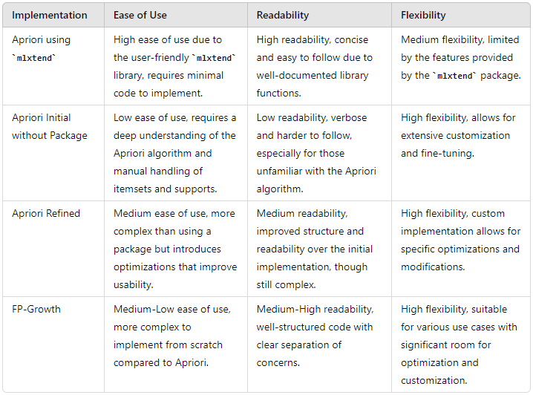
Qualitative Analysis

Slide 14
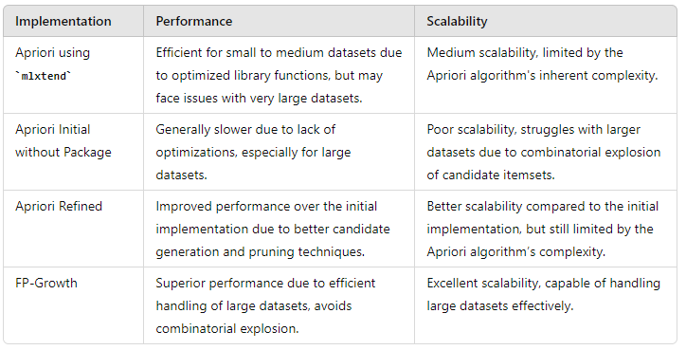
Quantitative Analysis

Slide 15
Qualitative Analysis vs Quantitative Analysis
Qualitative | Quantitative
mlxtend Apriori: Utilized the `mlxtend` library's built-in Apriori algorithm for a straightforward and efficient implementation. Custom Apriori: Implemented the Apriori algorithm from scratch on `data.txt` to understand the core mechanics and functionality without external packages. Refined Apriori: Enhanced the custom Apriori algorithm for `Music.txt` with optimization techniques such as pruning and a `TransactionsHandler` for efficient support calculations. FP-Growth: Applied the FP-Growth algorithm to `Music.txt`, leveraging its compressed FP-tree representation for faster and more scalable frequent itemset mining. | Data Size: The `data.txt` file contains 7 lines, while the `Music.txt` file has 2,165,409 lines. mlxtend Apriori: For `Music.txt`, memory limitations cause a computer crash; for `data.txt`, it runs in 1.5 seconds. Custom Apriori: For `Music.txt`, it faces memory limitations and takes over 10 hours to run; for `data.txt`, it runs in 0.01 seconds. Refined Apriori: For `Music.txt`, it runs in 31.5 seconds; for `data.txt`, it runs in 0.0001 seconds. FP-Growth: For `Music.txt`, it runs in 11.7 seconds.

Slide 16
Qualitative and Quantitative Analysis
The analysis of frequent itemset mining approaches on `data.txt` and `Music.txt` highlights distinct trade-offs between ease of use, performance, and scalability. The `mlxtend` Apriori algorithm offers a user-friendly and efficient solution for small datasets but struggles with larger ones due to memory limitations. Custom Apriori implementations provide flexibility and slight speed advantages for small datasets but are inefficient and impractical for large-scale data. The refined Apriori algorithm significantly enhances performance through optimizations but remains limited by the algorithm's inherent complexity. In contrast, the FP-Growth algorithm demonstrates superior efficiency and scalability, making it the optimal choice for large datasets, effectively balancing performance and resource usage.

Slide 17

Data Output
Note:
We’re only providing screenshots for partial results, for full fledged result use the .txt files.

Slide 18

TASK 1: Apriori Algorithm Implementation With Packages
In this section, we will implement the Apriori algorithm using the `mlxtend` package with a `min_support` of 0.05 on `data.txt`. We will follow these steps:​
Install Required Packages: Ensure that the mlxtend package is installed.​​
Load Data: Read the transaction data from data.txt.​​
Transform Data: Use TransactionEncoder to transform the data into a format suitable for the Apriori algorithm.​​
Apply Apriori Algorithm: Use the apriori function from the mlxtend package to find frequent itemsets.​​
Display Results: Print the resulting frequent itemsets.​​

Slide 19
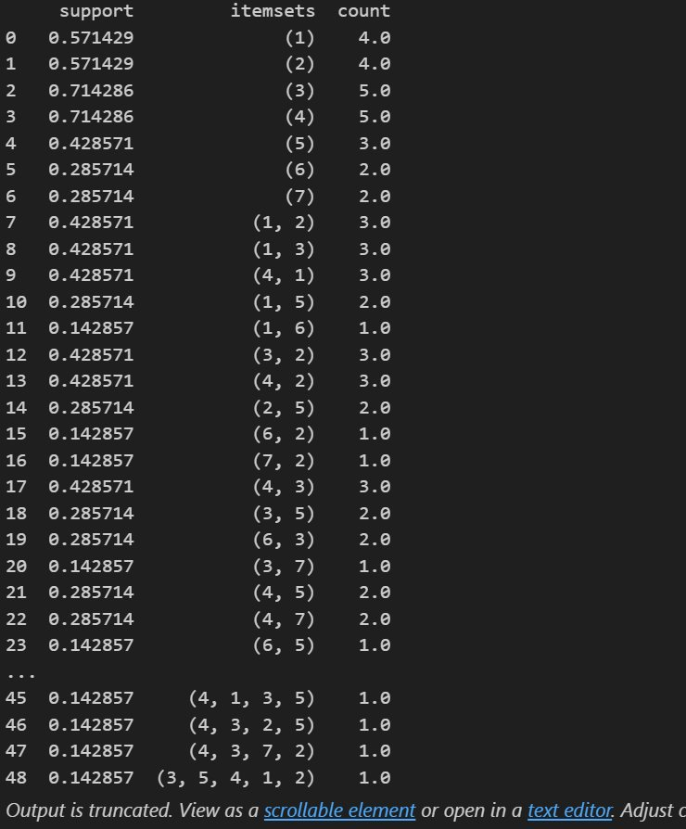
Results

Slide 20
TASK 2: Apriori Algorithm Implementation Without Packages​
​ ​
​ ​ ​ ​ ​
We will implement the Apriori algorithm without using any packages, with `min_support=0.05` on `data.txt`. The steps include defining helper functions to generate candidates, calculate support counts, and find frequent itemsets. Finally, we will load the data and apply the Apriori algorithm to find the frequent itemsets.

Slide 21
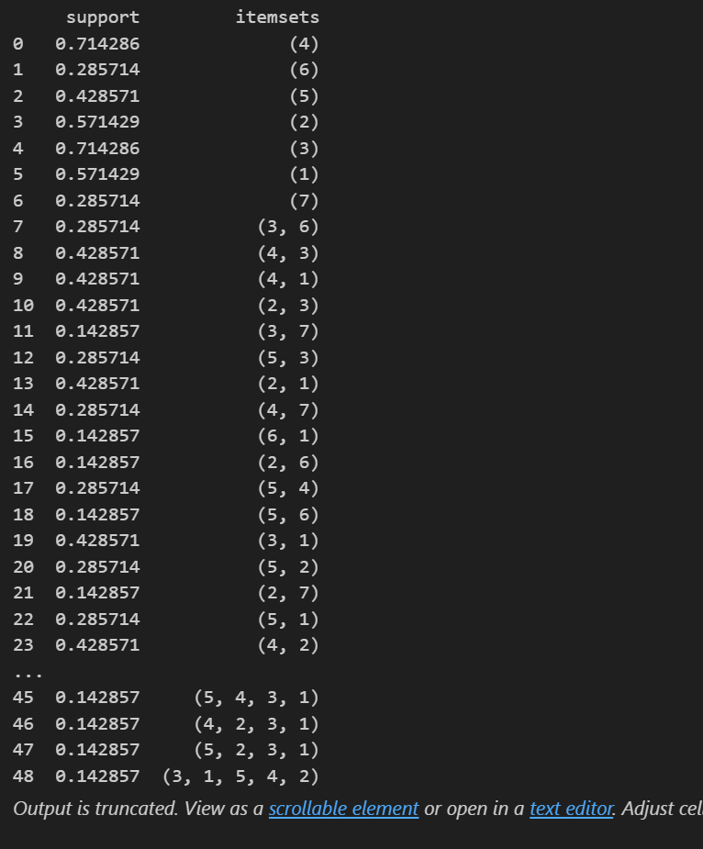
Results

Slide 22

TASK 3: Apriori Algorithm Implementation Without Packages for Various `min_support` Values
In this section, we will implement the Apriori algorithm without using any packages. We will use three different `min_support` values: 0.0003, 0.0006, and 0.0009 on `Music.txt`.

Slide 23
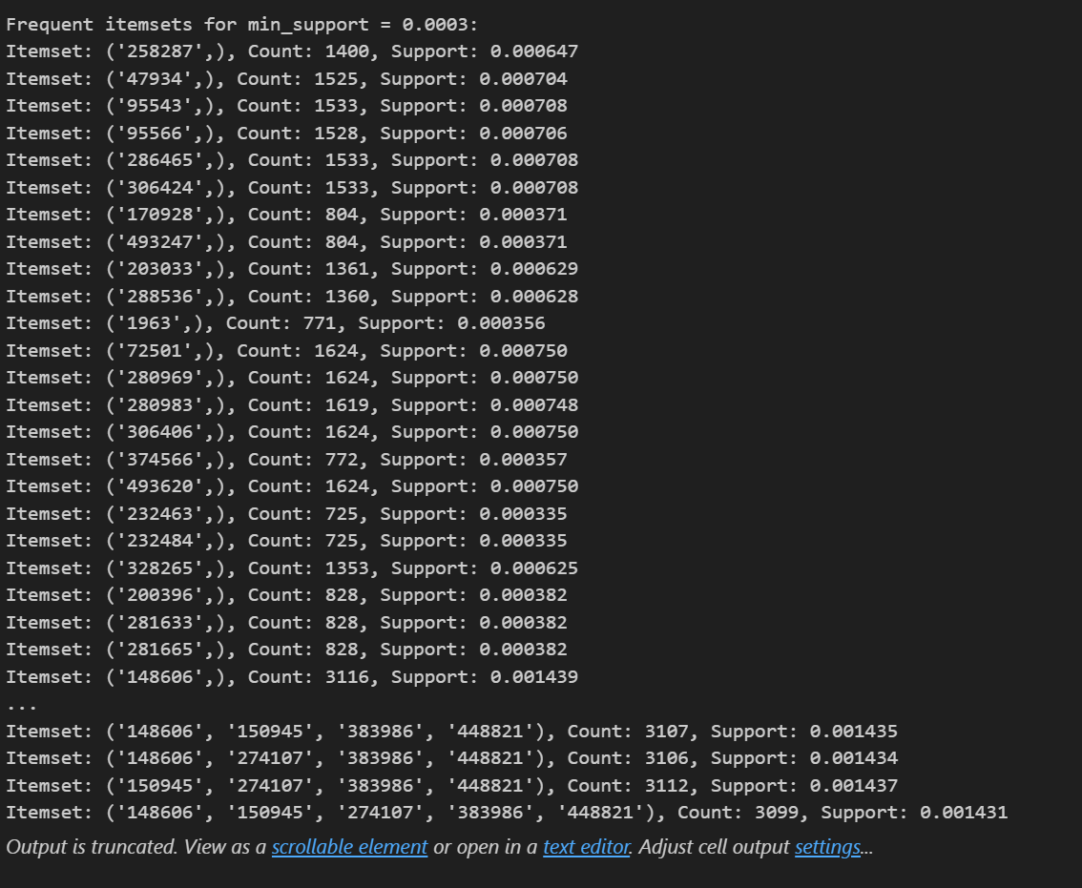
Results

Slide 24

Task 4: Apriori Algorithm Implementation in R
In this section, we will implement the Apriori algorithm in R with a `min_support` of 0.05 on `Data.txt`.
We utilize the arules package library for implementation of apriori in R.

Slide 25
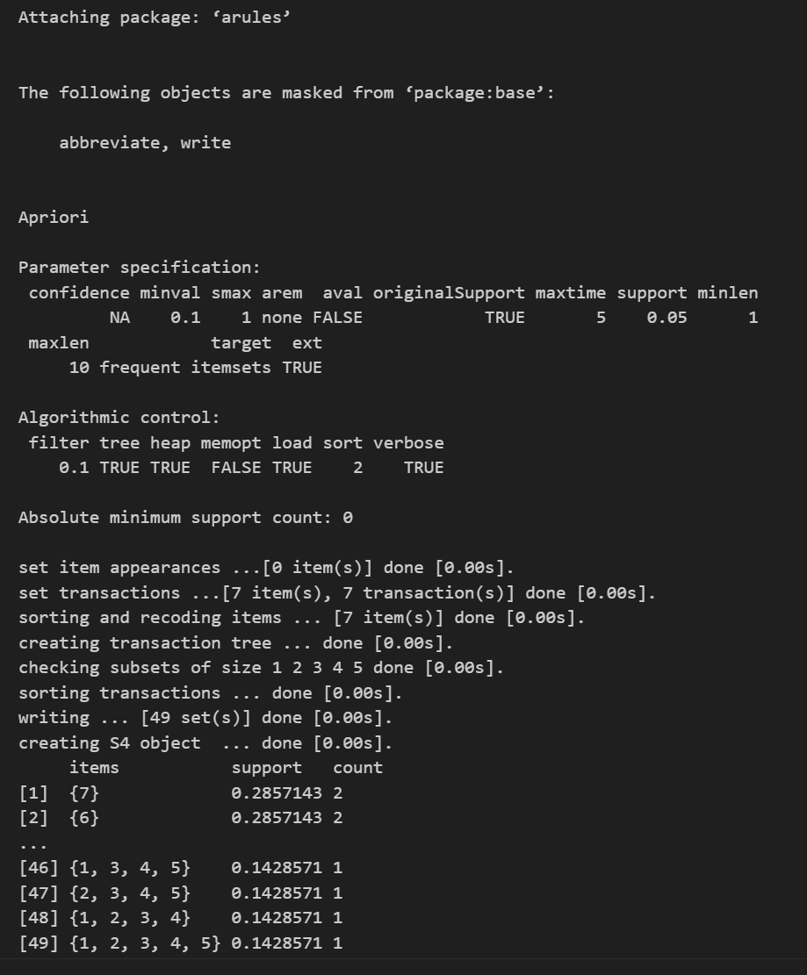
Results

Slide 26

Bonus 5: Mechanisms to Further Improve the Performance of the Original Apriori Algorithm (FP-Growth)
In this section, we will explore mechanisms to
improve the performance of the original Apriori
algorithm. The Apriori algorithm, while fundamental,
can be inefficient for large datasets due to the need
for multiple database scans and the generation of
candidate itemsets. To address these inefficiencies,
we will implement the FP-Growth algorithm, which
is known for its efficiency in finding frequent
itemsets.

Slide 27
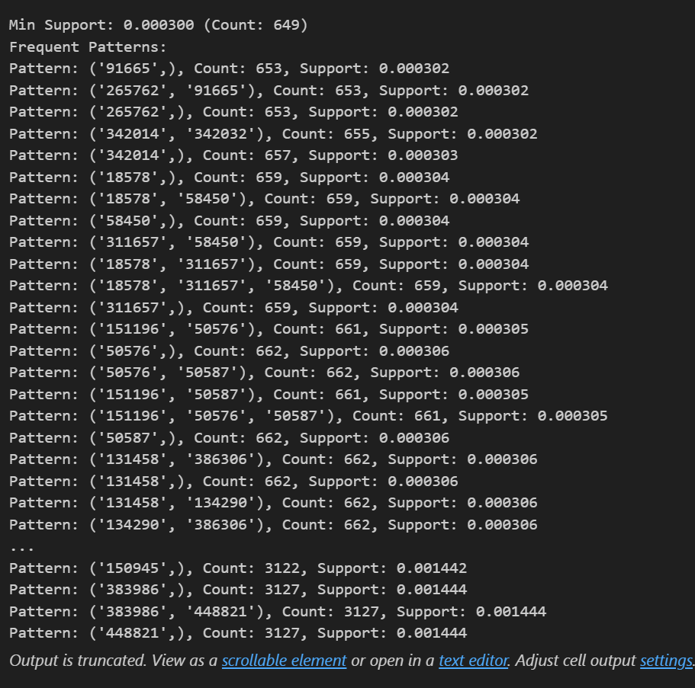
Results

Slide 28

Bonus: Implement the Apriori Algorithm on a Real Database and Analyze Meaningful Patterns of Customer Shopping Behavior
This document details the implementation of the Apriori algorithm on the Groceries
dataset to analyze meaningful patterns in the shopping behavior of customers.
Dataset Description
The Groceries dataset from Kaggle contains transactions from a grocery store. Each
Transaction lists the items purchased by a customer. The dataset can be downloaded
from [Kaggle – Groceries
Dataset (https://www.kaggle.com/heeraldedhia/groceries-dataset).
Dataset Format
Customer: A unique identifier for each customer.
-Item: The items purchased by the customer.

Slide 29
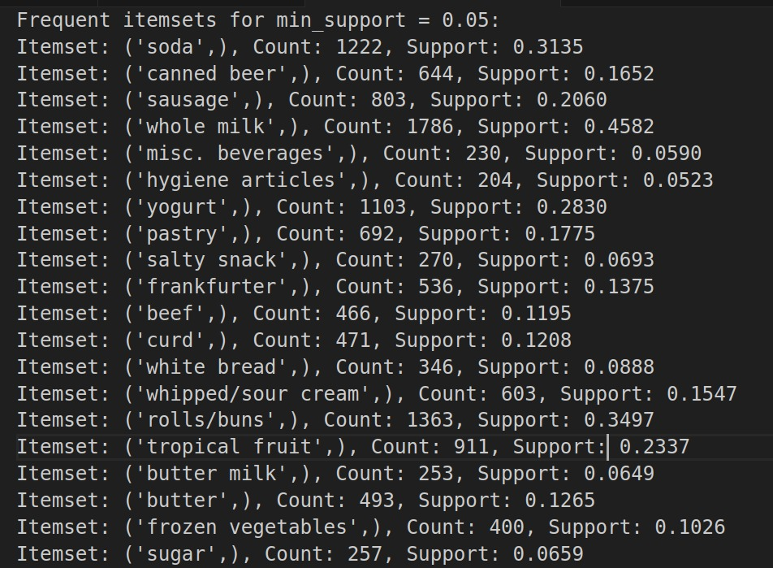
Results
Frequent itemsets for min-support 0.05

Slide 30
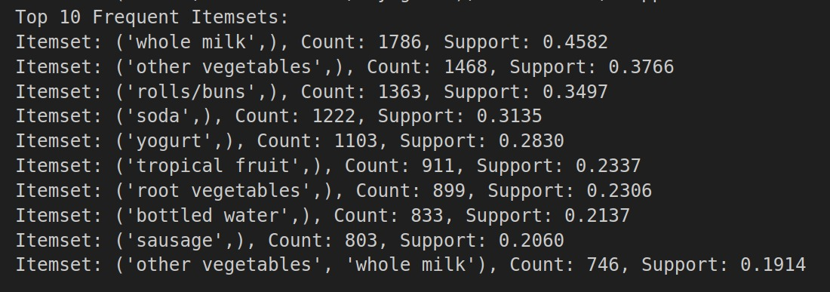
Results (Cont.)
Top ten frequent itemsets

Slide 31
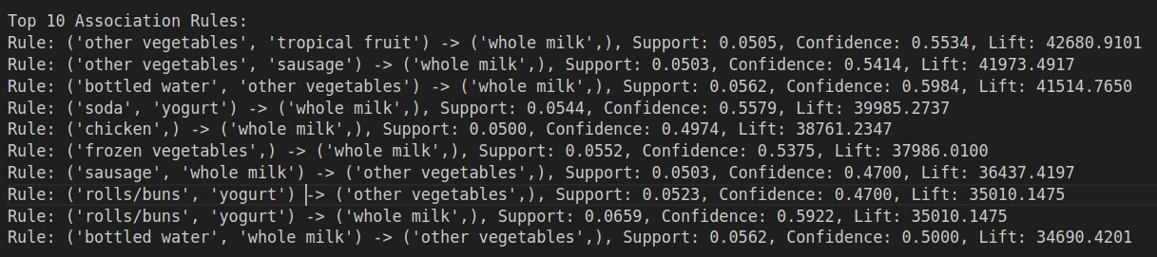
Results (Cont.)
Top ten association rules

Slide 32

Roles and Contributions

Slide 33
Division of project roles and contributions
We both Muhammad Junaid Ali Asif Raja (M11217073) and Muhammad Aown Ali (M11217077) worked on the project together. Original Presentation is made by Muhammad Aown Ali and it is further refined by Mr. Muhammad Junaid Ali Asif Raja.
Tasks | Muhammad Aown Ali | Muhammad Junaid Ali Asif Raja
Data Preprocessing | ✔ | ✔
Task 1 (with pkg) | ✔
Task 2(w/o pkg) |  | ✔
Task 3 (Music.txt w/o pkg) |  | ✔
Task 4 ( R language) | ✔
Task 5 (FP-Growth) |  | ✔
Task 6 (Real Database) | ✔ | ✔

Slide 34

xiè xie

